Slide 1


Botastra
Pitch-a-bot
Name – Ayush Ranjan
Adm. No. – 21je0215
Problem Statement No. – 7A

Slide 2
Problem Statement -
In the present scenario of introduction of new variants of Covid-19 every now and then, various authorities have imposed varying restrictions on the number of people allowed to gather inside a venue depending on the local spread of covid. To help the authorities in implementing this policy in an efficient manner for the National Museum, you as a young innovator are required to devise a solution using appropriate sensor(s) which would count the number of people entering and leaving the museum. You have to think and implement how you would count the people entering and leaving the museum and display the current number of people who are inside on a LCD display. You must also display the number of people which can currently enter, given the total regulatory number and must also display “ALERT” if the number crosses the total permitted number given by the regulatory authority for the National Museum. You should also try to make your solution as economical as possible.

Slide 3
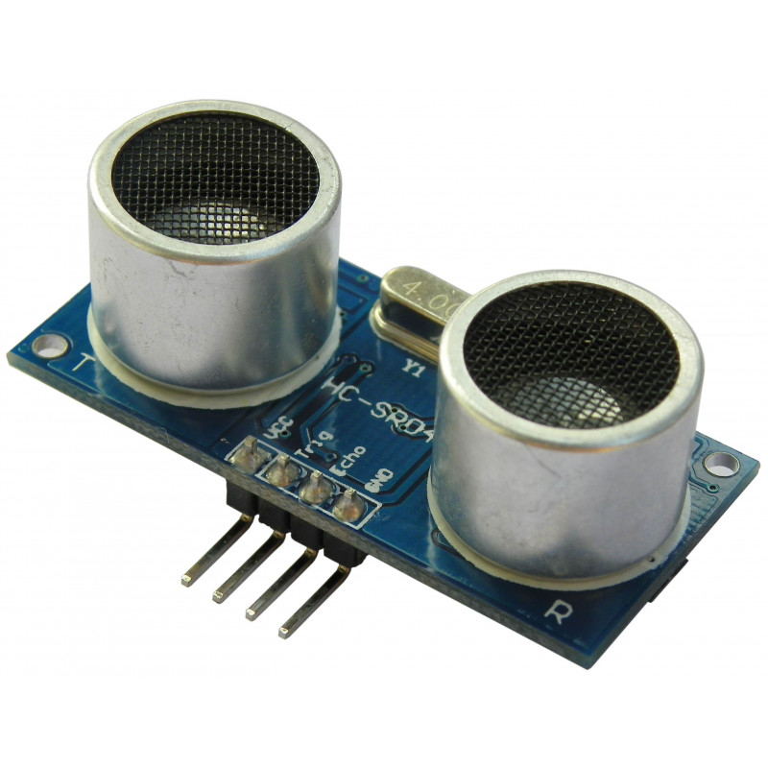
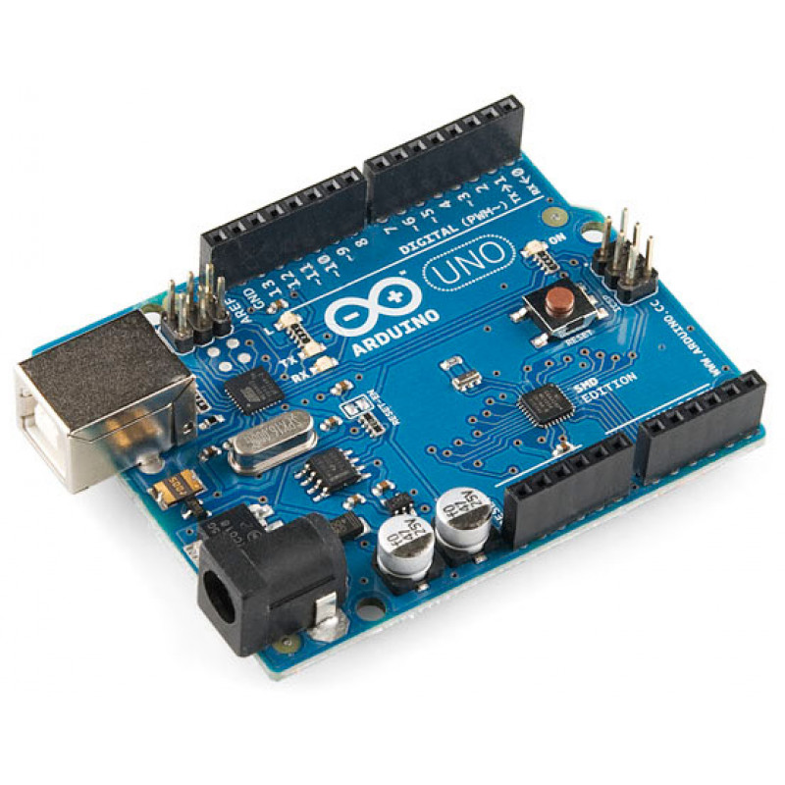
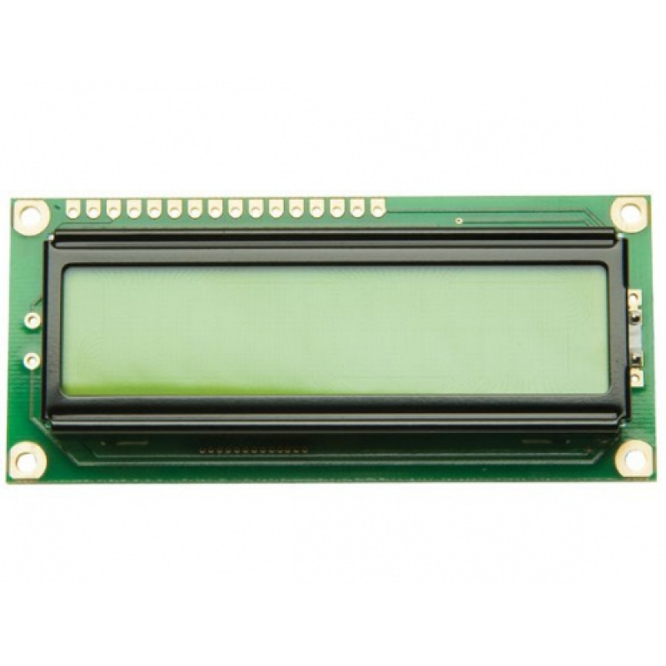
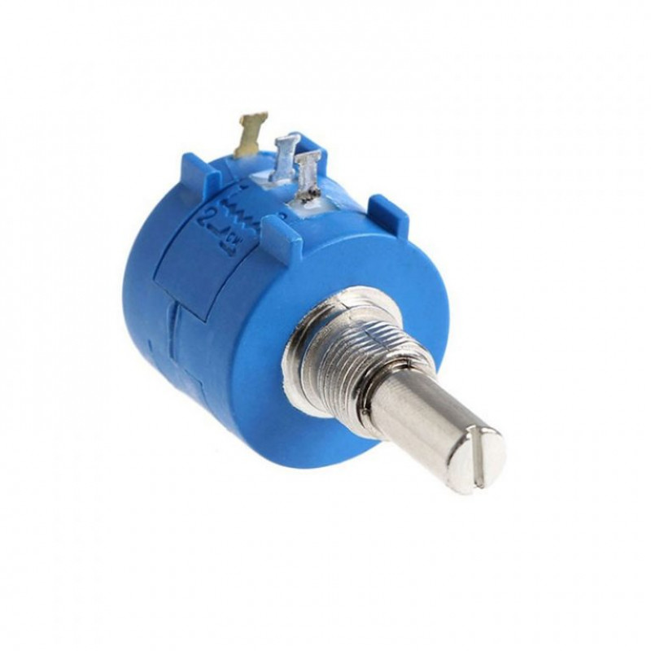
Components Required -
Ultrasonic Distance Sensor Module - HC-SR04 (2 units)
Price – Rs 59 × 2 = Rs 118
Arduino UNO R3 SMD Atmega328P Board
Price – Rs 445
16x2 (1602) Character Green Backlight LCD Display
Price – Rs 115
10k Ohm 3590S Precision Multiturn Potentiometer
Price – Rs 139
Total Price – Rs 817

Slide 4
Software Used -
Arduino IDE – For programming Arduino UNO.
Fritzing – For making circuit diagram.
Wokwi – For the making of Virtual Circuit.
Link for the Wokwi Project-
https://wokwi.com/arduino/projects/323819320143512147

Slide 5

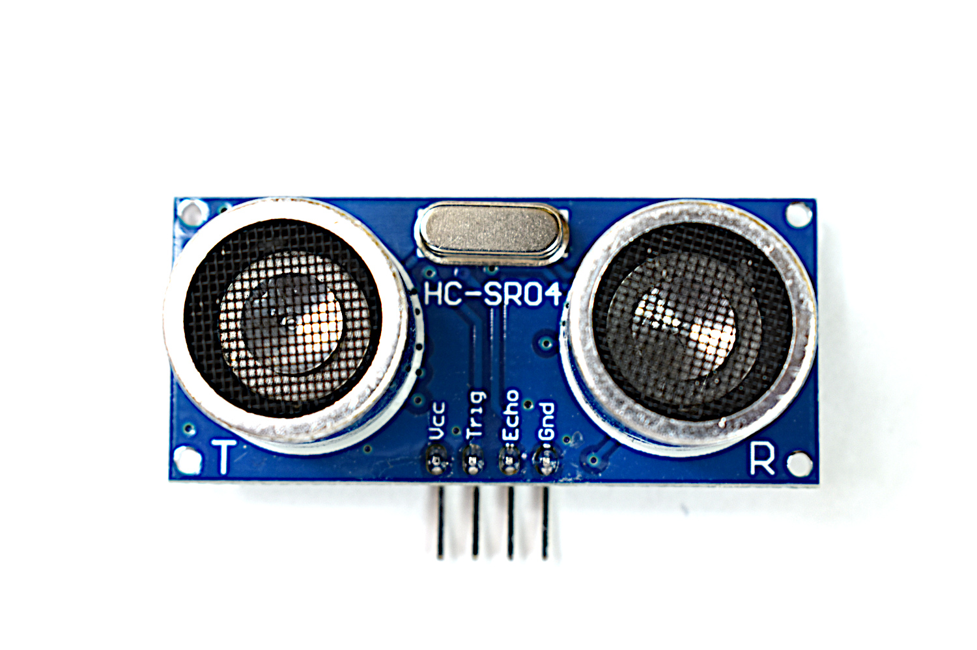
Approach towards the problem -
My priorities – Lowest cost and highest accuracy.
An ultrasonic distance sensor will be used for human detection on both sides of the gate, in the shown position.
Entrance Gate
Place your hand in front of the sensor
sensor

Slide 6
Before entering the gate, each person will have to place their hands (Or any other body part) in front of the sensor to get registered.
They are not needed to touch the sensor or any other part, which will prevent the spread of Covid 19.
The range of the sensor will be kept to a minimum (2 to 6 cm), which will increase the accuracy as it will prevent it from confusing any other object with entering human.
If a person is registered on the Entrance side, There will be an increment in the present count of the inside population.
On the other hand, there will be a decrement if a person is registered on the exit side.

Slide 7
Problems faced during the process of problem-solving -
Problem faced in selecting the sensor-
a) Infrared sensor was not suitable, as it can give wrong data for black surfaces.
b) PIR has a very wide field of view which may cause false detection.
c) Doppler effect radar sensor(HB100) was rejected, as it is quite sensitive to motion.
2. Figuring out about using multiple sensors with a single Arduino UNO was quite tricky.
3. Connecting LCD with Arduino and selecting the suitable potentiometer that can give flexibility over contrast was quite confusing.
4. Solving the problem using a single gate and making it economical at the same time.
5. Still, the project is not fully automatic, but making it fully automatic could risk accuracy.

Slide 8
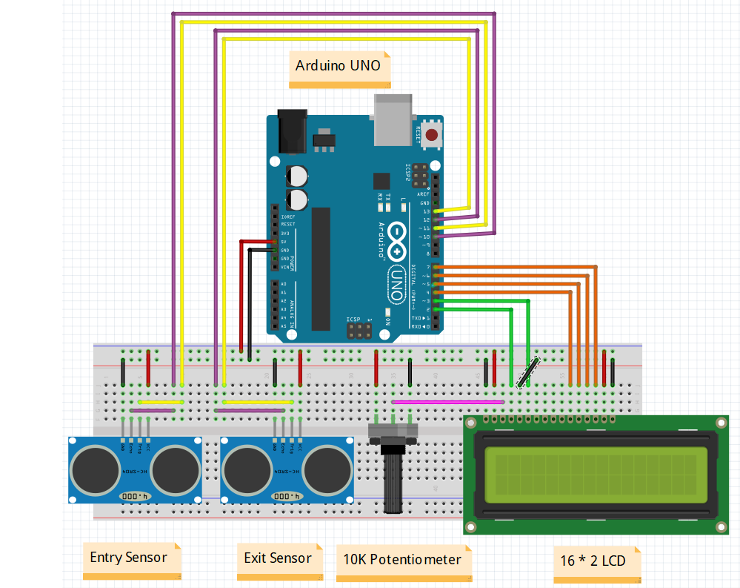
Detailed Circuit diagram.
Detailed Circuit diagram

Slide 9
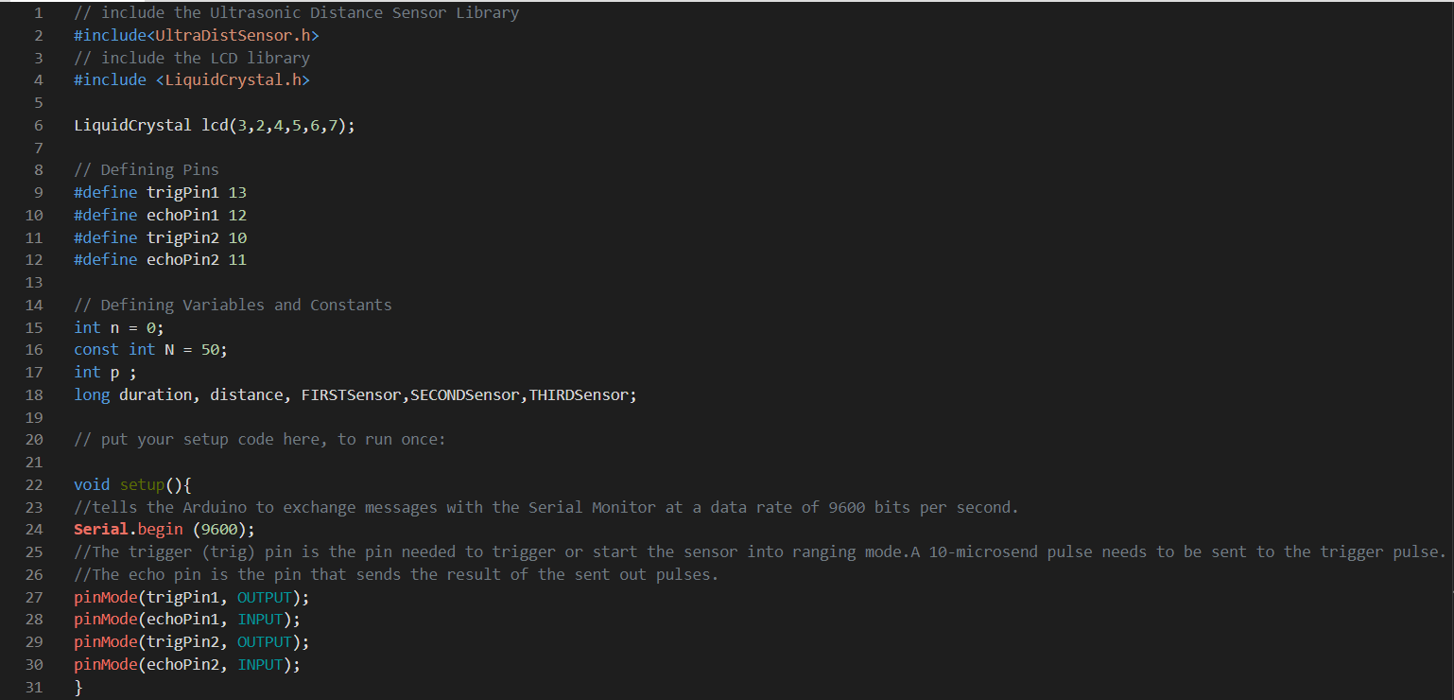
Code in Arduino IDE

Slide 10
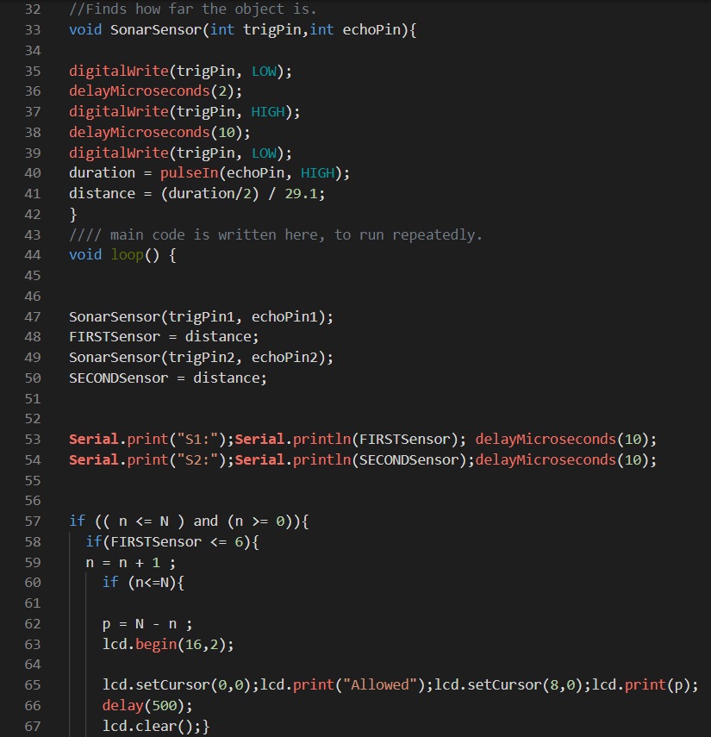

Slide 11
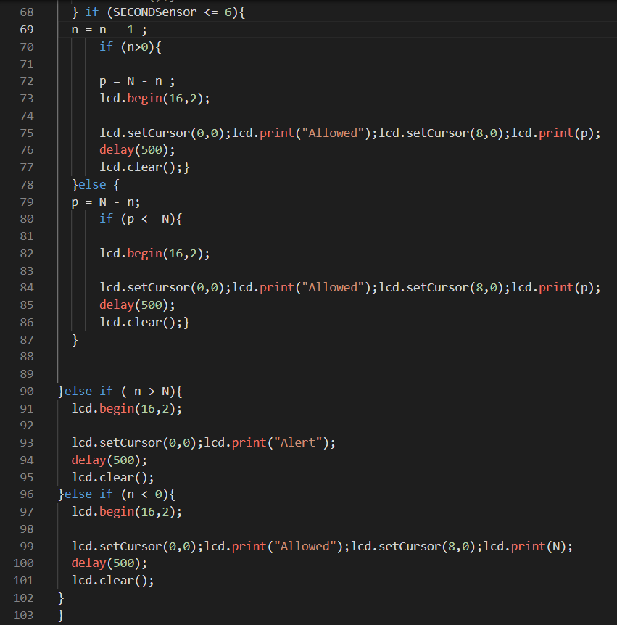

Slide 12
Takeaways -
Gained a lot of knowledge about various sensors, their working Principles, and uses.
Learned to use Arduino UNO with different sensors and LCD.
Learned to use Fritzing.
Learned to use Wokwi.
Learned the basics of programming using Arduino IDE.
Learned to assemble the circuit on a breadboard.

Slide 13
Future Scope -
We can make it fully automatic by separating the Entry and Exit gates. But it can increase the cost and can take more space than available.
We can use some advanced techniques to make sure that the object in the range of the sensor is a hand of a person.

Slide 14
References -
Buy Electronics Components Online in India - Electronic Components Store
YouTube
https://www.google.co.in/
Arduino Project Hub
http://robu.in/
https://www.tinkercad.com/

